Slide 1
The Formation and Development of a Worldview
Sessions 3 and 4
Dr. Lewis Winkler • East Asia School of Theology (Singapore) Uploaded by Dr. Rick Griffith • Jordan Evangelical Theological Seminary Files in many languages for free download at BibleStudyDownloads.org

Slide 2
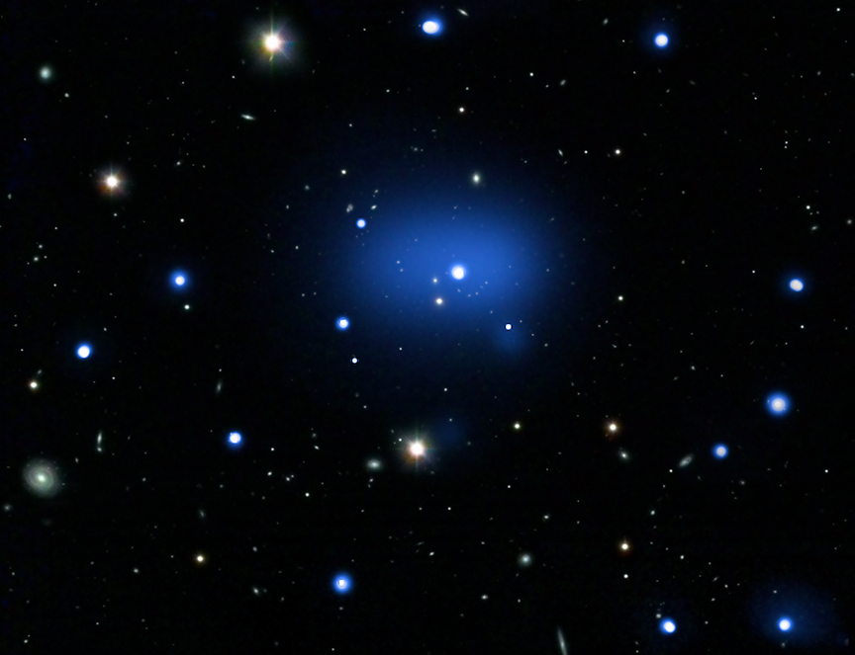
Introduction

Slide 3
The Beginnings of a Worldview
Pretheoretical:

Slide 4
The Beginnings of a Worldview
Pretheoretical:
Innate Capacities:

Slide 5
The Beginnings of a Worldview
Pretheoretical:
Innate Capacities:
Innate Personality:

Slide 6
The Beginnings of a Worldview
Location, Location, Location!

Slide 7
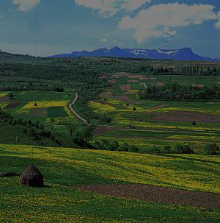
The Beginnings of a Worldview
Location, Location, Location!
Geographical Factors:

Slide 8
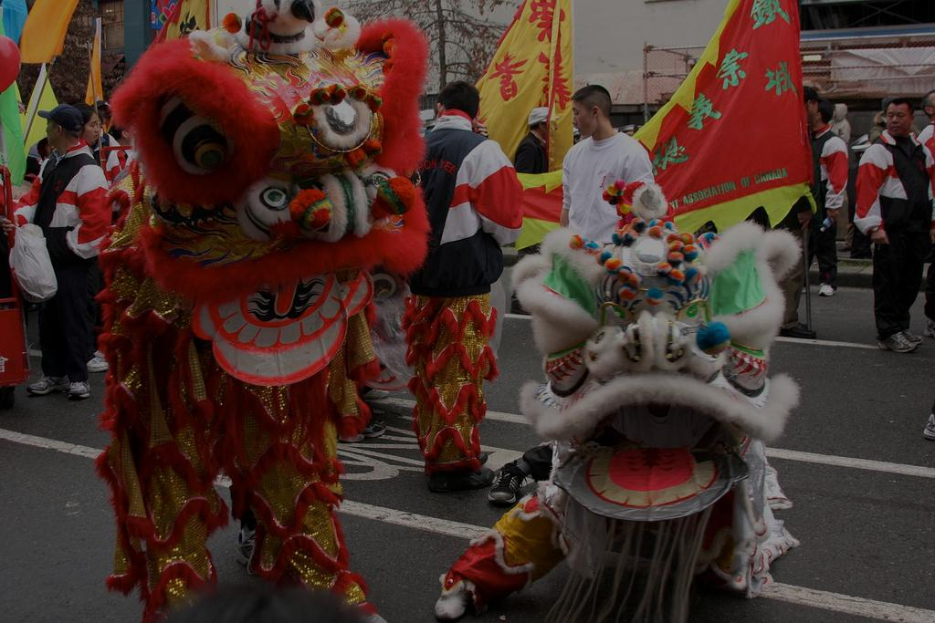
The Beginnings of a Worldview
Location, Location, Location!
Geographical Factors:
Cultural Factors:

Slide 9
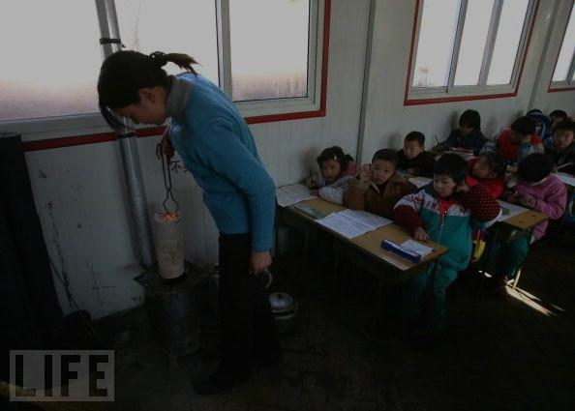
The Beginnings of a Worldview
Location, Location, Location!
Geographical Factors:
Cultural Factors:
Social and Educational Institutions:

Slide 10
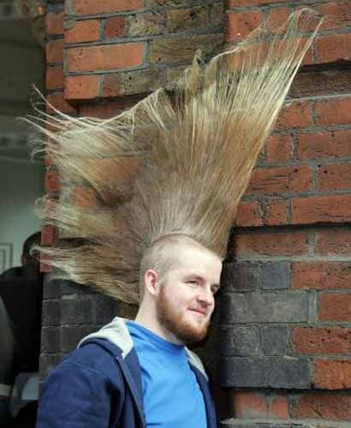
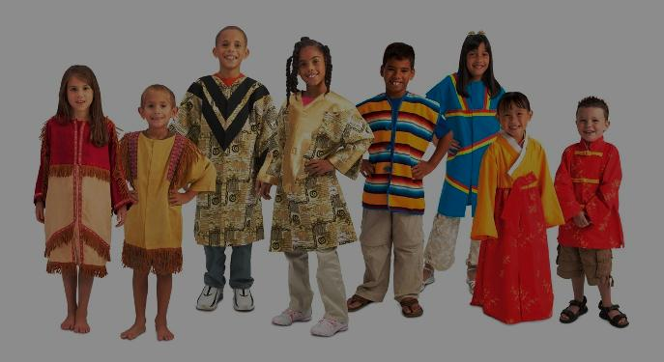
The Beginnings of a Worldview
Location, Location, Location!
Geographical Factors:
Cultural Factors:
Social and Educational Institutions:
Clothing, Body, and Hairstyles:

Slide 11
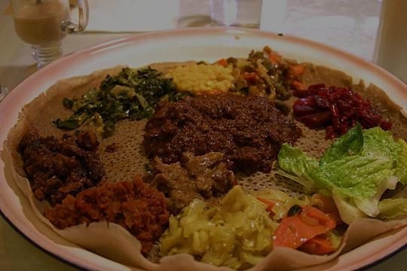
The Beginnings of a Worldview
Location, Location, Location!
Geographical Factors:
Cultural Factors:
Social and Educational Institutions:
Clothing, Body and Hairstyles:
Food and Drink:

Slide 12
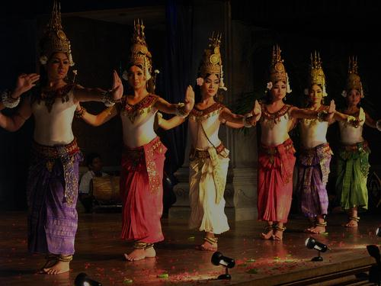
The Beginnings of a Worldview
Location, Location, Location!
Geographical Factors:
Cultural Factors:
Social and Educational Institutions:
Clothing, Body and Hairstyles:
Food and Drink:
Music and Dance:

Slide 13
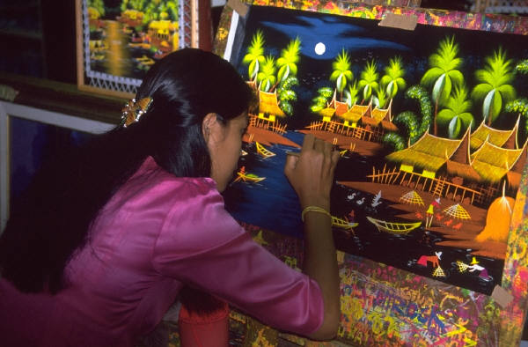
The Beginnings of a Worldview
Location, Location, Location!
Geographical Factors:
Cultural Factors:
Social and Educational Institutions:
Clothing, Body and Hairstyles:
Food and Drink:
Music and Dance:
Art Forms and Media:

Slide 14
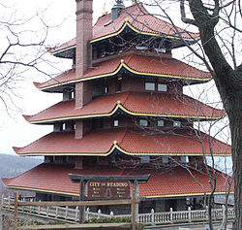
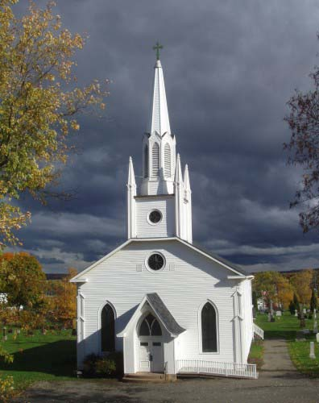
The Beginnings of a Worldview
Location, Location, Location!
Geographical Factors:
Cultural Factors:
Architecture and Building Styles:

Slide 15
The Beginnings of a Worldview
Location, Location, Location!
Geographical Factors:
Cultural Factors:
Architecture and Building Styles:
Authority and Social Structures:

Slide 16
The Beginnings of a Worldview
Location, Location, Location!
Cultural Factors:
Authority and Social Structures:
Egalitarian or Hierarchical?

Slide 17
The Beginnings of a Worldview
Location, Location, Location!
Cultural Factors:
Authority and Social Structures:
Egalitarian or Hierarchical?
Matriarchal or Patriarchal?

Slide 18
The Beginnings of a Worldview
Location, Location, Location!
Cultural Factors:
Authority and Social Structures:
Egalitarian or Hierarchical?
Matriarchal or Patriarchal?
Formal or Informal?

Slide 19
The Beginnings of a Worldview
Location, Location, Location!
Cultural Factors:
Authority and Social Structures:
Egalitarian or Hierarchical?
Matriarchal or Patriarchal?
Formal or Informal?
Genealogical/Imparted or Earned?

Slide 20
The Beginnings of a Worldview
Location, Location, Location!
Cultural Factors:
Authority and Social Structures:
Egalitarian or Hierarchical?
Matriarchal or Patriarchal?
Formal or Informal?
Genealogical/Imparted or Earned?
Communal or Individual?

Slide 21
The Beginnings of a Worldview
Location, Location, Location!
Cultural Factors:
Authority and Social Structures:
Egalitarian or Hierarchical?
Matriarchal or Patriarchal?
Formal or Informal?
Genealogical/Imparted or Earned?
Communal or Individual?
Traditional/Conservative or Liberal

Slide 22
The Beginnings of a Worldview
Location, Location, Location!
Cultural Factors:
Sources of Credibility:

Slide 23
The Beginnings of a Worldview
Location, Location, Location!
Cultural Factors:
Sources of Credibility:
Gathering Styles:

Slide 24
The Beginnings of a Worldview
Location, Location, Location!
Cultural Factors:
Sources of Credibility:
Gathering Styles:
Holidays:

Slide 25
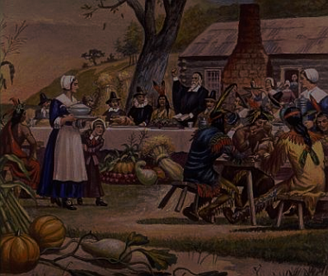
The Beginnings of a Worldview
Location, Location, Location!
Cultural Factors:
Sources of Credibility:
Gathering Styles:
Holidays:
Traditions:

Slide 26
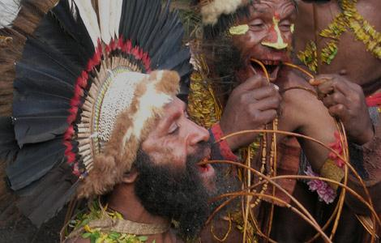
The Beginnings of a Worldview
Location, Location, Location!
Cultural Factors:
Sources of Credibility:
Gathering Styles:
Holidays:
Traditions:
Rituals:

Slide 27
The Beginnings of a Worldview
Location, Location, Location!
Cultural Factors:
General Cultural Setting and Nature:

Slide 28
The Beginnings of a Worldview
Location, Location, Location!
Cultural Factors:
General Cultural Setting and Nature:
Conservative or Liberal?

Slide 29
The Beginnings of a Worldview
Location, Location, Location!
Cultural Factors:
General Cultural Setting and Nature:
Conservative or Liberal?
Static or Changing/Dynamic?

Slide 30
The Beginnings of a Worldview
Location, Location, Location!
Cultural Factors:
General Cultural Setting and Nature:
Conservative or Liberal?
Static or Changing/Dynamic?
Developed, Developing, or Regressing?

Slide 31
The Beginnings of a Worldview
Location, Location, Location!
Technological Factors:

Slide 32
The Beginnings of a Worldview
Location, Location, Location!
Technological Factors:
Religious Factors:

Slide 33
The Beginnings of a Worldview
Location, Location, Location!
Technological Factors:
Religious Factors:
Ideological and Philosophical Factors:

Slide 34
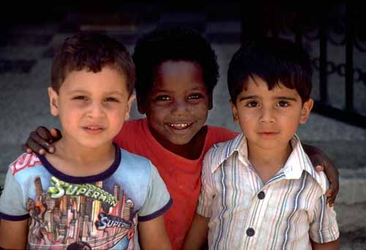
The Beginnings of a Worldview
Location, Location, Location!
Technological Factors:
Religious Factors:
Ideological and Philosophical Factors:
Racial Factors:

Slide 35
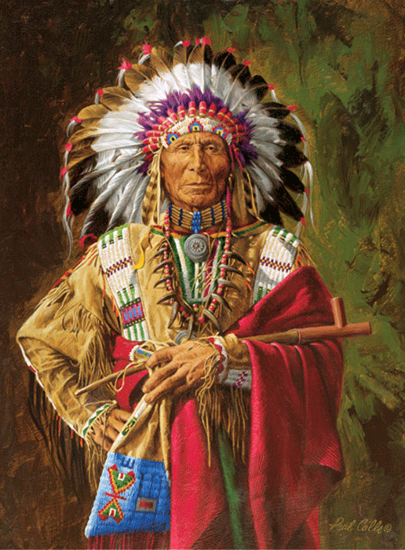
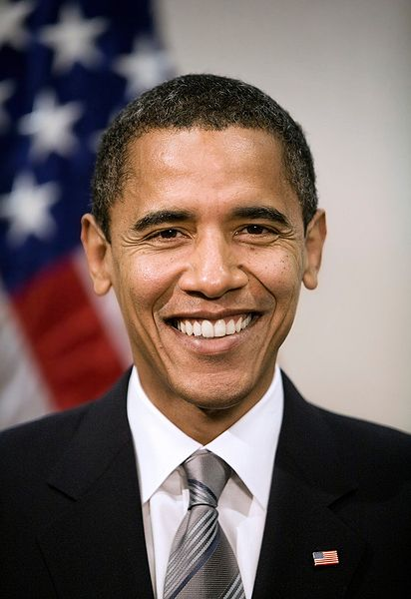
The Beginnings of a Worldview
Location, Location, Location!
Technological Factors:
Religious Factors:
Ideological and Philosophical Factors:
Racial Factors:
Political Factors:

Slide 36
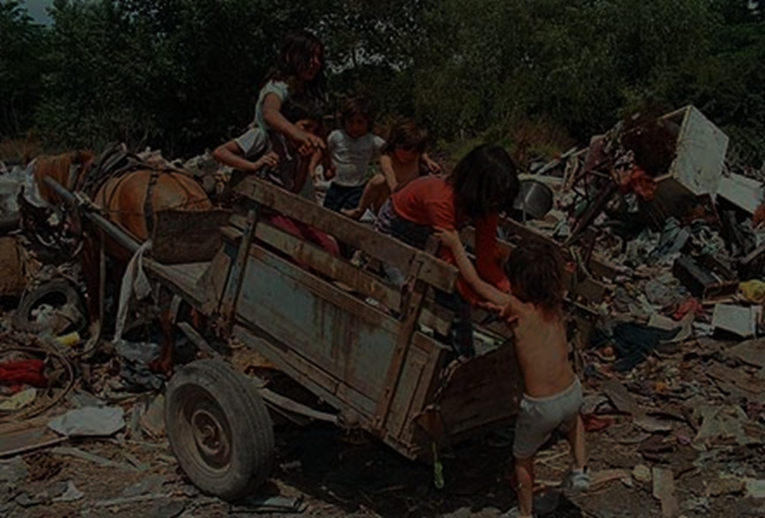
The Beginnings of a Worldview
Location, Location, Location!
Technological Factors:
Religious Factors:
Ideological and Philosophical Factors:
Racial Factors:
Political Factors:
Familial and Socioeconomic Factors:

Slide 37
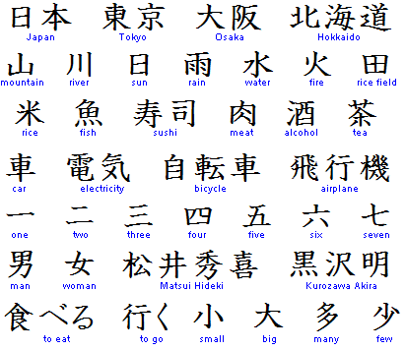
The Beginnings of a Worldview
Location, Location, Location!
Linguistic Factors:

Slide 38
The Beginnings of a Worldview
Location, Location, Location!
Linguistic Factors:
Demographical Factors:

Slide 39
The Beginnings of a Worldview
Location, Location, Location!
Linguistic Factors:
Demographical Factors:
Mythological Factors:

Slide 40
The Beginnings of a Worldview
Location, Location, Location!
Linguistic Factors:
Demographical Factors:
Mythological Factors:
Think of your own!

Slide 41
The Beginnings of a Worldview
Because all of the previous elements are dynamic and in constant flux, worldviews are not static, even if some are more conservative than others.

Slide 42
The Beginnings of a Worldview
The Obvious Result: Explicit beliefs and practices are closely linked to overt ideas about both the way things are and should be.

Slide 43
The Beginnings of a Worldview
The More Subtle Result: A set of deeply held assumptions (sometimes called, “enthymemes”) and often unconscious actions and judgments stem from basic convictions about both the way the world really is and should be.

Slide 44
The Development and Ordering of a Worldview
A growing body of experiences in the world produces a need for an expanded set of resources to make sense of the world.

Slide 45
The Development and Ordering of a Worldview
A growing body of experiences in the world produces a need for an expanded set of resources to make sense of the world.
Depending on where we were raised and what we were exposed to (as well as how frequently), the resources at our disposal and how we decide to use them vary greatly.

Slide 46
The Development and Ordering of a Worldview
Distinctly Christian Resources and Perspectives for Developing a Genuinely Christian Worldview:
Some General Observations from a Christian Point of View:

Slide 47
The Development and Ordering of a Worldview
Distinctly Christian Resources and Perspectives for Developing a Genuinely Christian Worldview:
Some General Observations from a Christian Point of View:
Although they contain culturally and religiously neutral aspects, because they are products of finite and sin-tainted human beings, worldviews are not neutral.

Slide 48
The Development and Ordering of a Worldview
Distinctly Christian Resources and Perspectives for Developing a Genuinely Christian Worldview:
Some General Observations from a Christian Point of View:
Thus, every worldview likely contains idolatrous as well as good aspects of belief, behavior, and moral evaluation.

Slide 49
The Development and Ordering of a Worldview
Distinctly Christian Resources and Perspectives for Developing a Genuinely Christian Worldview:
Some General Observations from a Christian Point of View:
There is an enemy of our souls who wants to deceive, discourage, distract, and destroy us from living in the freedom of a genuinely Christian view of God’s world (Genesis 3:1-6; John 8:44, 10:10a; 2 Corinthians 4:4, 10:3-5, 11:3; Ephesians 6:10-20; 1 Peter 5:8-10).

Slide 50
The Development and Ordering of a Worldview
Distinctly Christian Resources and Perspectives for Developing a Genuinely Christian Worldview:
Distinctly Christian Resources for Worldview Formation:
The Reality of the Image of God in Every Human Being (Genesis 1:27, 9:6; James 3:9):

Slide 51
The Development and Ordering of a Worldview
Distinctly Christian Resources and Perspectives for Developing a Genuinely Christian Worldview:
Distinctly Christian Resources for Worldview Formation:
God’s Revelation, Both General and Special (Psalm 19; Romans 1:18-2:29; 2 Timothy 3:16-17; Hebrews 4:12):

Slide 52
The Development and Ordering of a Worldview
Distinctly Christian Resources and Perspectives for Developing a Genuinely Christian Worldview:
Distinctly Christian Resources for Worldview Formation:
God, through the Holy Spirit, Who Is at Work in Us to Bring About Life Transformation (John 14:26; 16:7-13):

Slide 53
The Development and Ordering of a Worldview
Distinctly Christian Resources and Perspectives for Developing a Genuinely Christian Worldview:
Distinctly Christian Resources for Worldview Formation:
Christ’s Body, the Church (1 Corinthians 12; Ephesians 4):

Slide 54
The Development and Ordering of a Worldview
Distinctly Christian Resources and Perspectives for Developing a Genuinely Christian Worldview:
Distinctly Christian Resources for Worldview Formation:
Hope: An Anticipatory Glimpse into the Future of the World (1 Corinthians 15; Revelation 21):

Slide 55
Conclusion:

Slide 56
Black

Slide 57
Worldview link at BibleStudyDownloads.org
Get this presentation for free!
Notes:
WV (Worldviews)

